Slide 1
Island Hopper
David Garber
Midterm Game
GAME601 Game Prototyping
October 18th, 2020

Slide 2
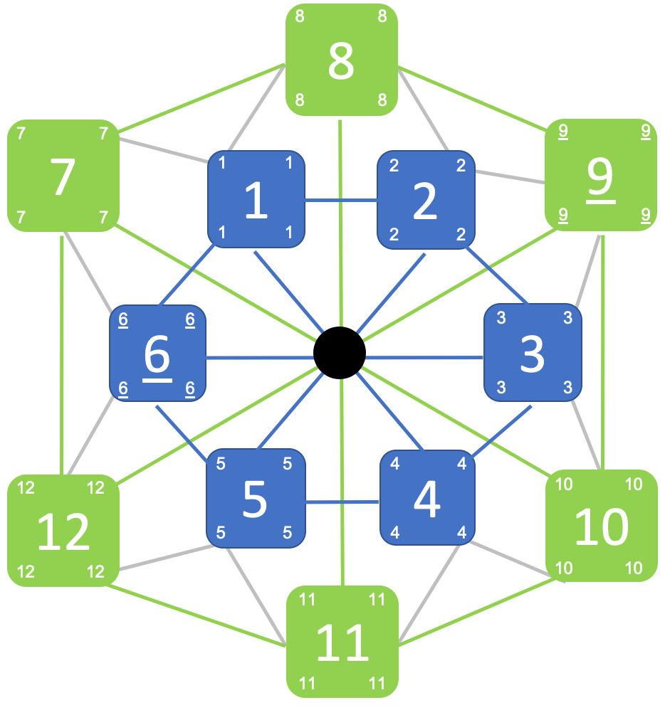
overview
Island Hopper is a game of conquest! Take over the map
Similar to Risk
12 numbered islands correspond to sides of D12
Primary game mechanic: player actions directed by die roll
Player actions include:
Develop
Explore
War
Free Move

Slide 3
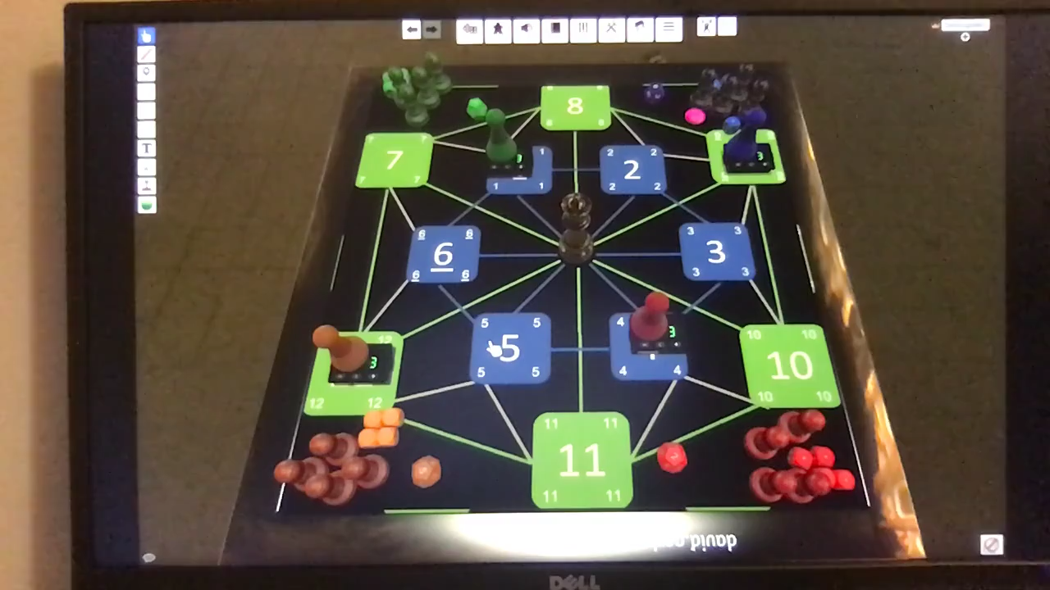

Slide 4


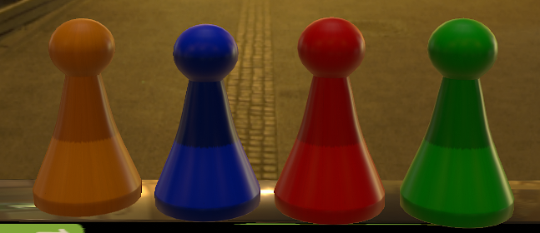
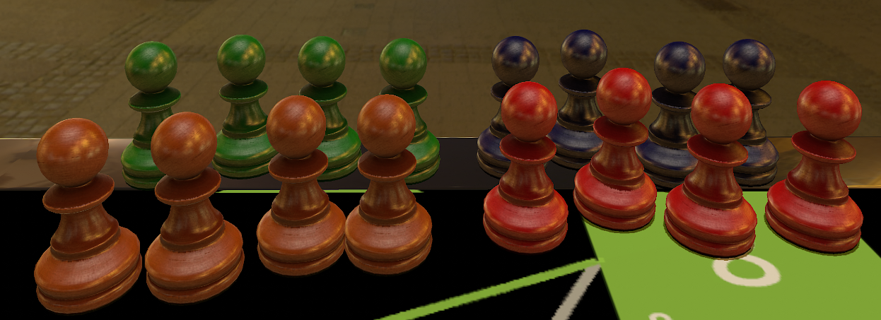

Iconagraphy / game elements
Tabletop Simulator:
King (use King or Rook)*
Garrison (use Pawn or Knight/Bishop)*
For a 4-player game, use one king and one rook from each color of a single chess set (as the 4 Kings), along with all 4 pawns of each color along with the knights and bishops (as the 4 Garrisons for each player)
*Free images from TheNounProject.com

Slide 5
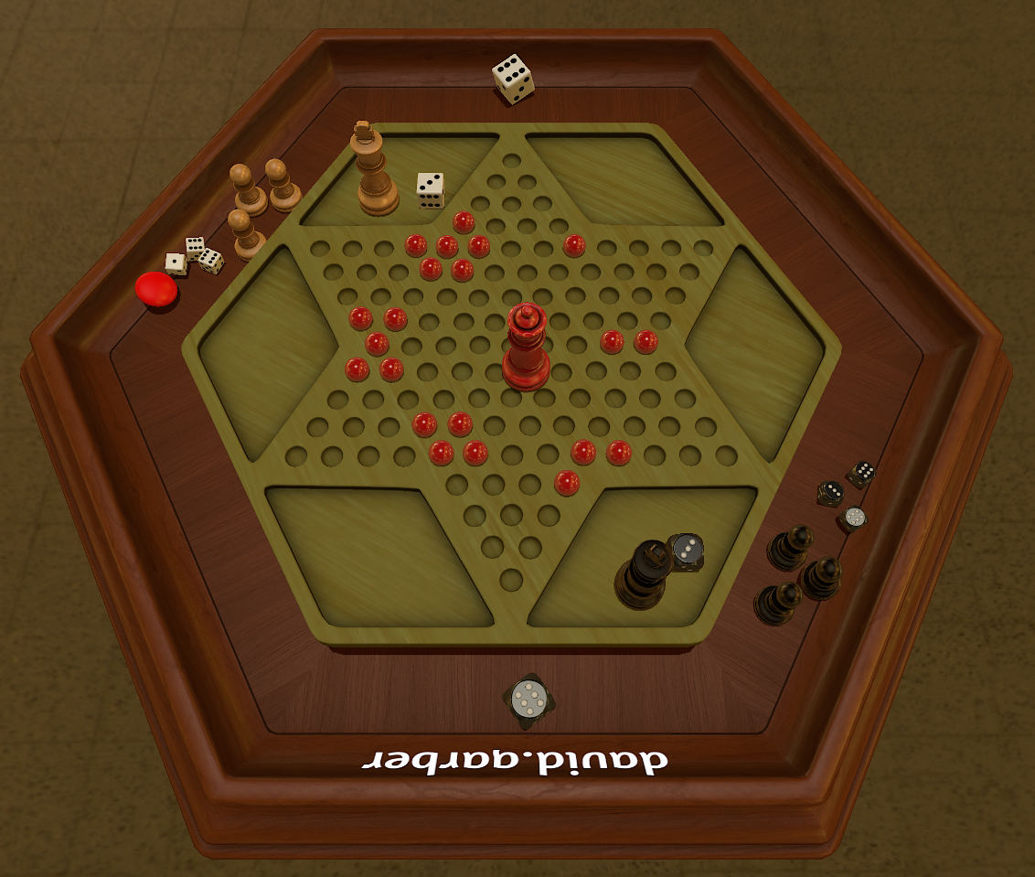
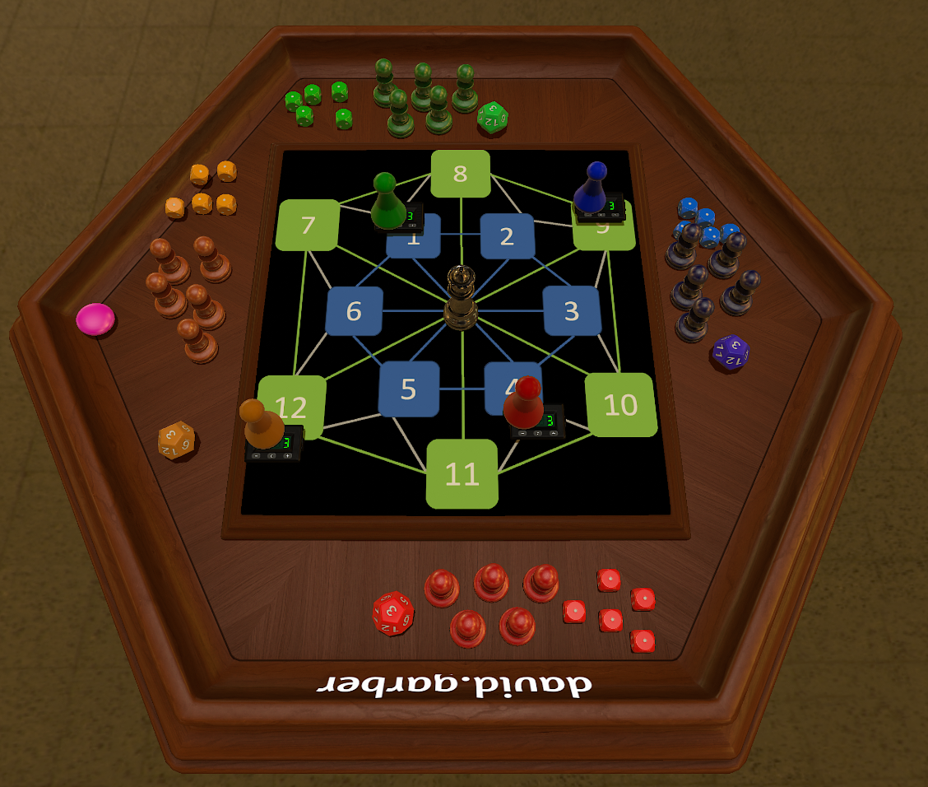
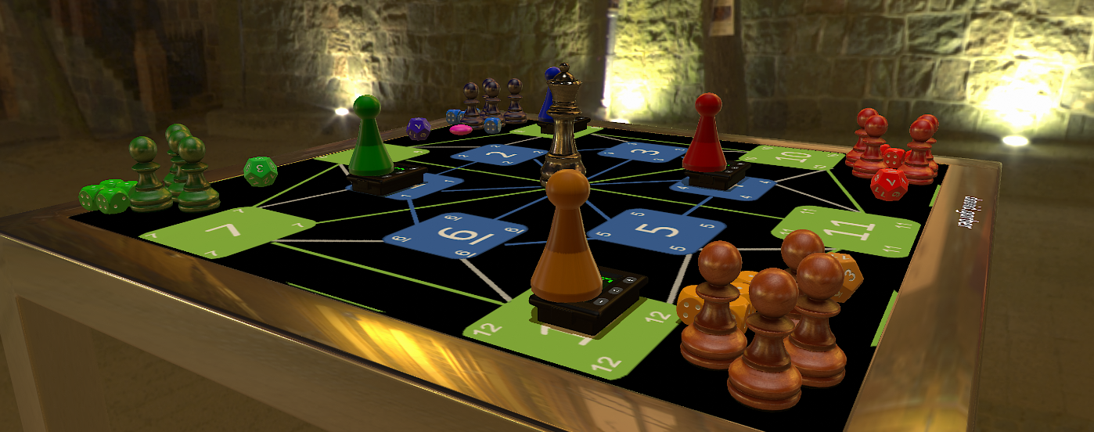
Playtesting / development
Version 1
Version 2
Started with 2-player version (6 islands)
Wanted players to choose an action each turn (Develop, Explore, War), found game to be too deterministic
Added ‘random’ element of D6 die roll
Added complexity with Robber in middle
Expanded to 3 or 4-player version (12 islands)
Two D6 doesn’t keep same probability for each island; switched to D12
Added connecting paths to keep similar ratio of adjacent / non-adjacent islands (3/3 and 5/7)
Affects survivability of the King!
Added role for eliminated players (move Robber, develop Garrisons)
Tweaked Robber mechanics (-1 health to Garrisons rather than outright removal)
Version 3

Slide 6
Thank you!

